Slide 1
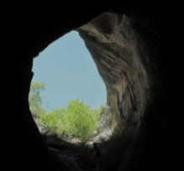
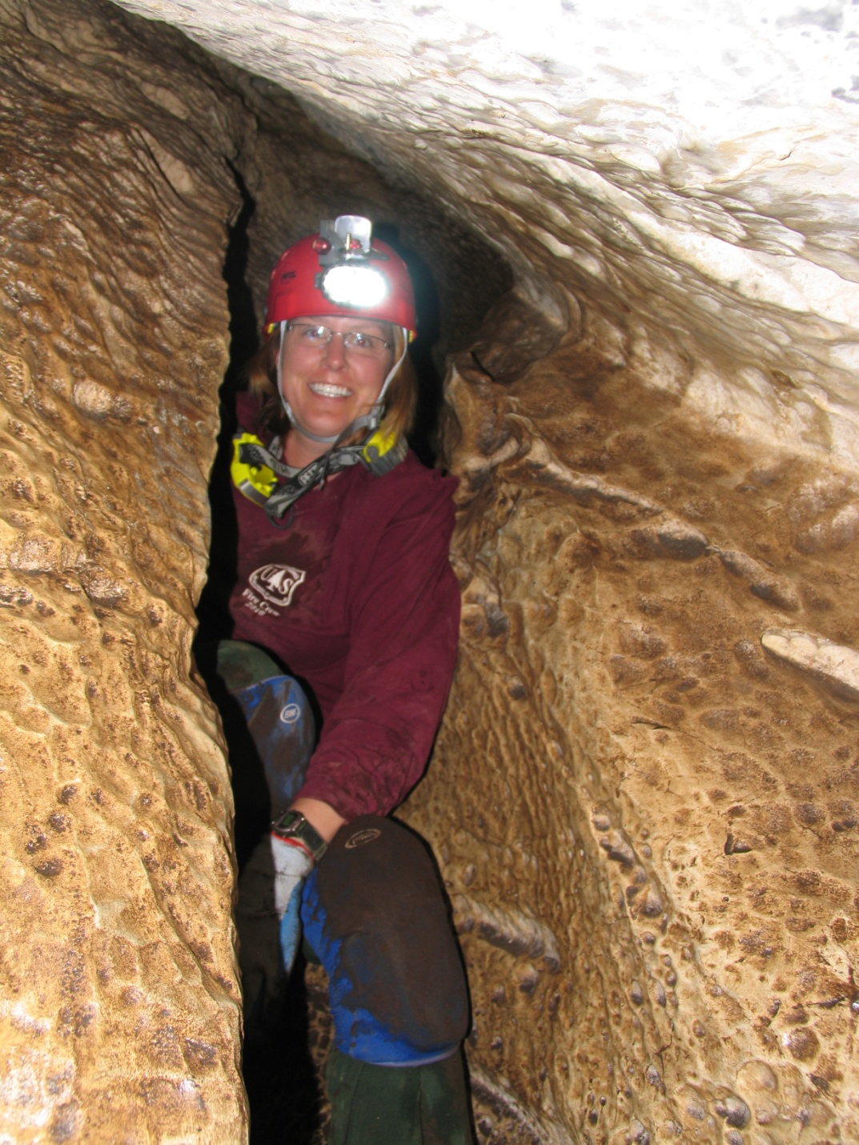
Types of Caves
Cynthia Sandeno
National Cave and Karst Coordinator
U.S. Forest Service
Educators and students: you are welcome to freely use the images from this presentation in school projects or presentations, whether printed or projected, without requesting permission, so long as they are not used in any media being sold or made for profit. For such use, contact me at cmsandeno@fs.fed.us.
Notes:
Educators and students: you are welcome to freely use the images from this presentation in school projects or presentations, whether printed or projected, without requesting permission, so long as they are not used in any media being sold or made for profit. For such use, contact me at cmsandeno@fs.fed.us.

Slide 2
Distribution of Caves
Notes:
Carol just gave us a great overview of karst topography and the types of features that make up this landscape. If you look at this map of the distribution of caves, you will notice that the location of caves correspond pretty closely to the major karst areas that Carol showed us in her presentation.
For the rest of tonight’s webinar, we are going to narrow our focus from this broader landscape of karst and talk specifically about the underground world of caves and the unusual and rare species that live in cave environments both today and in the past.
According to the records kept by the National Speleological Society, there are nearly 60,000 known caves in the United States. Isn’t that incredible.
And, “known" is the operative word. In the western U.S., there are large expanses of federally-owned lands that have not been completely explored.
We have been able to find a lot of “new caves” over the last few decades by studying bats. By capturing bats in the summer and putting small transmitters on their backs, we have been able to track them to caves that we did not know existed. And, with the emergence of WNS, we have also discovered new caves by finding dead bats outside of their entrances.
If you look at this map closely you will notice that it CLICK

Slide 3
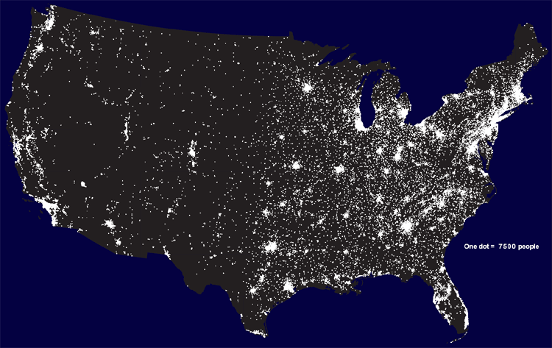
Distribution of People
Notes:
also correspond pretty closely to where the majority of Americans live.
So, tonight, as we talk about the importance of caves, karst, groundwater, and the species that make their home in these ecosystems, it is also important to remember that we have the ability to negatively impact or, better yet, to protect these critical habitats.

Slide 4
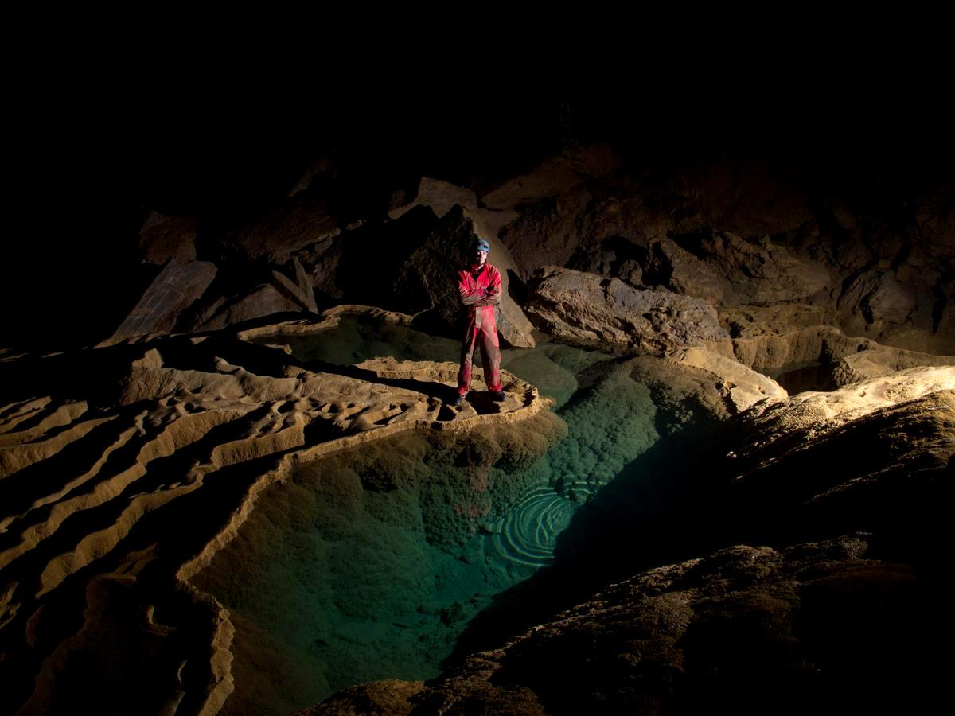
Cave Types
Lava Tubes
Erosional Caves
Sea Caves
Glacier Caves
Solution Caves
Photo by Carlin Kartchner
Notes:
Very quickly, I want to give you a broad overview of the different types of caves we have in the U.S, and give you a chance to see some really striking examples of each type. Because caves are so diverse, I've split them into 5 categories that we will cover very quickly.

Slide 5
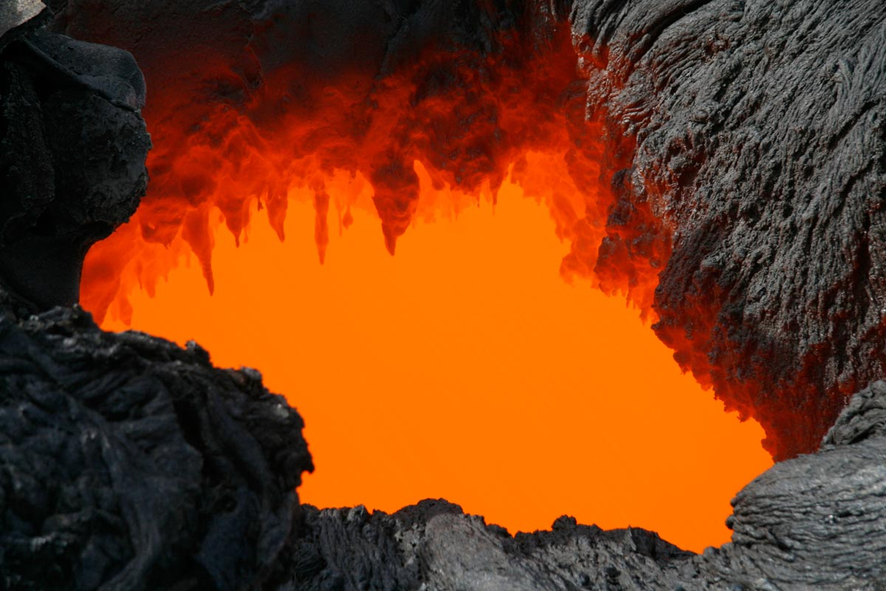
1. Lava Tubes
Photo by U.S. Geological Survey
Notes:
The first category is lava tubes. These caves are formed just like you would imagine. In volcanic area, lava flows down the sides of volcanoes in channels. The outer surface of the lava cools and molten lava continues to flow through the resulting tube. Once the supply of lava is cut off, the molten lava continues to flow out of the tube, leaving a void behind it.

Slide 6
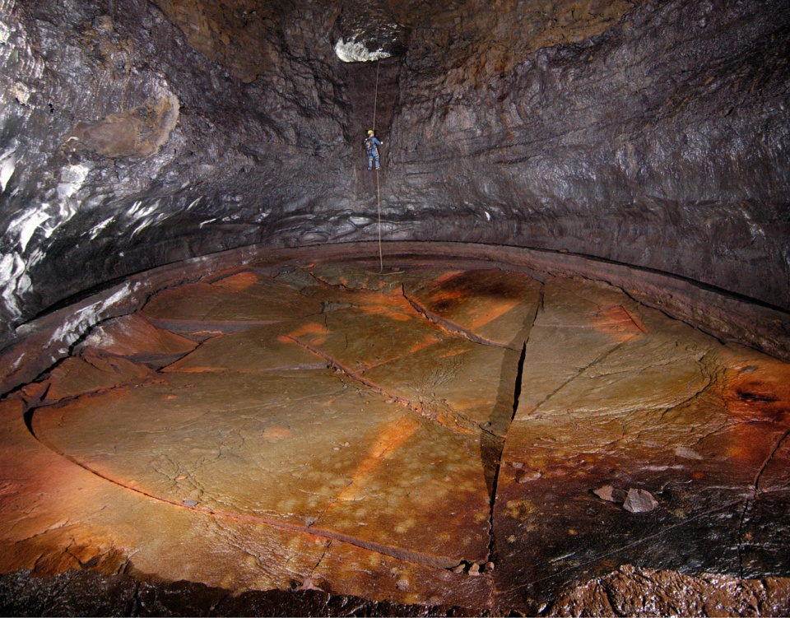
1. Lava Tubes
Photo by Dave Bunnell
Kazumura Cave is has been surveyed at 40.7 miles long and 3,614 feet deep making it the longest and deepest lava tube in the world..
Notes:
The longest and most extensive lava tubes are known from the Big Island of Hawaii including this Kazumura Cave. With over 40 miles of passage, this is the longest lava tube in the world, and the 36th longest cave in the world.
Lava tubes are found in they are also found in many other volcanic regions.

Slide 7
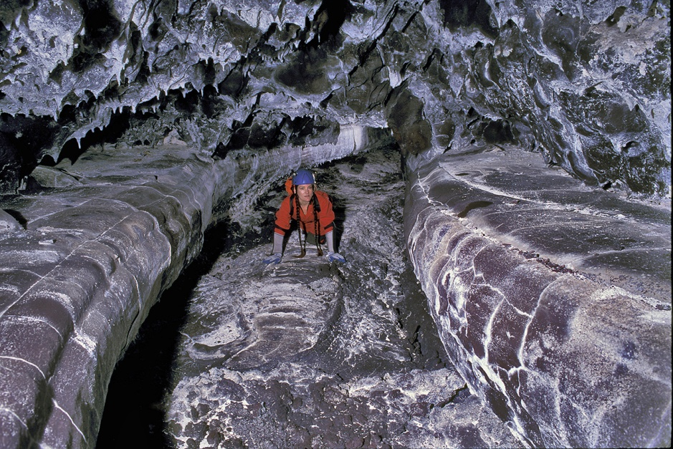
Lava Tubes
Photo by Dave Bunnell
A variety of speleothems may be found in lava tubes including lavacicles.
Secondary minerals may also be deposited in the tubes later, such as gypsum or calcite crystals.
Notes:
In this picture you can see how “cave-like” these lava tubes can be.
What else do you notice in the top of this picture?
Lava tubes can have formations. Formations can be formed at the same time as the cave is forming in which case they are made of lava. Or, they can be secondary minerals that are deposited after the cave is formed.

Slide 8
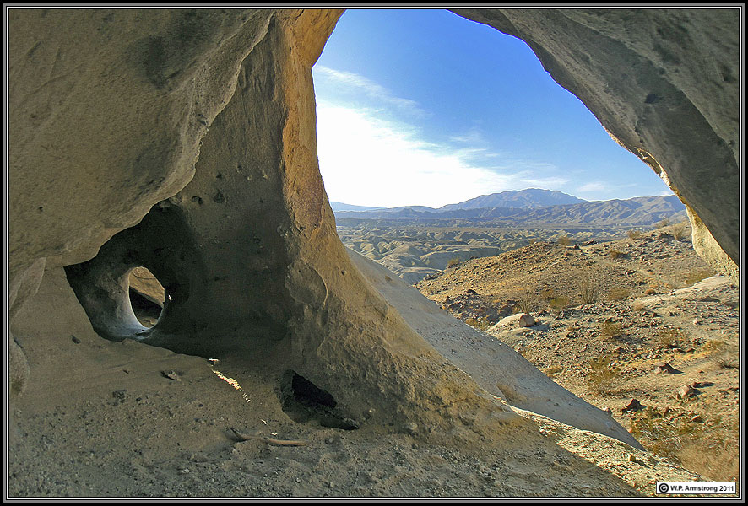
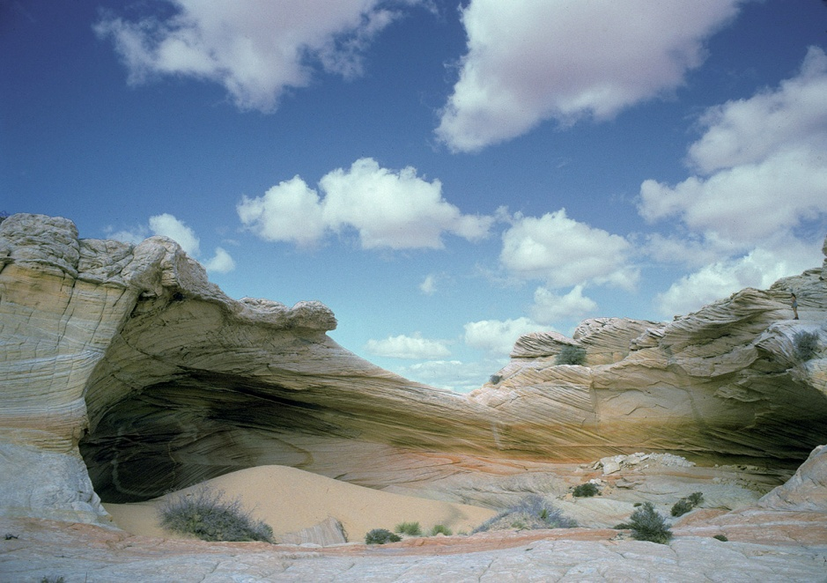
2. Erosional Caves
Photo by Dave Bunnell
Notes:
Erosional caves are formed when wind or water carries abrasive particles capable of carving rock. Generally, for a cave to form, there must be some initial weakness in the rock, such as a fracture, through which the process of weathering can begin to act.
Erosional caves can be found in almost any kind of rock, from hard granite to soft sandstone to sediments.
The caves created through this process can be large, but they are neither deep nor extensive.
CLICK
Erosion tends to produce tall, canyon-like passages.

Slide 9
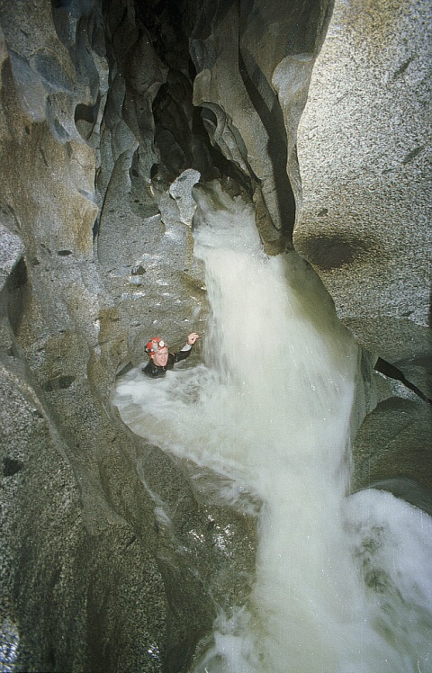
2. Erosional Caves
Photo by Dave Bunnell
Notes:
Some of the most spectacular erosional caves known are found in the mountainous regions of the western United States.
This photo is from one such cave system, where sand particles borne by floodwaters have carved out almost a mile of canyon passage.

Slide 10
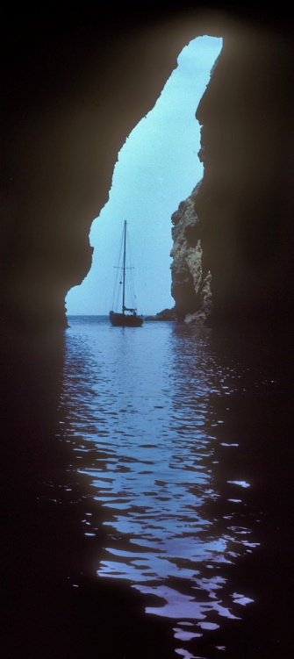
3. Sea Caves
Carved by the power of oceans.
Found all over the world and may be one of the most numerous types of caves.
Sea caves rarely have formations like solution caves or lava tubes.
Photo by Dave Bunnell
Notes:
Sea caves are carved by the power of the ocean, largely by wave action. They are formed when water attacks a crack or other weakness in coastal cliffs. As the sea reaches into these cracks, they begin to widen and deepen from both the weight of the water and the compression of air.
Sea caves are found along coasts throughout the world.

Slide 11
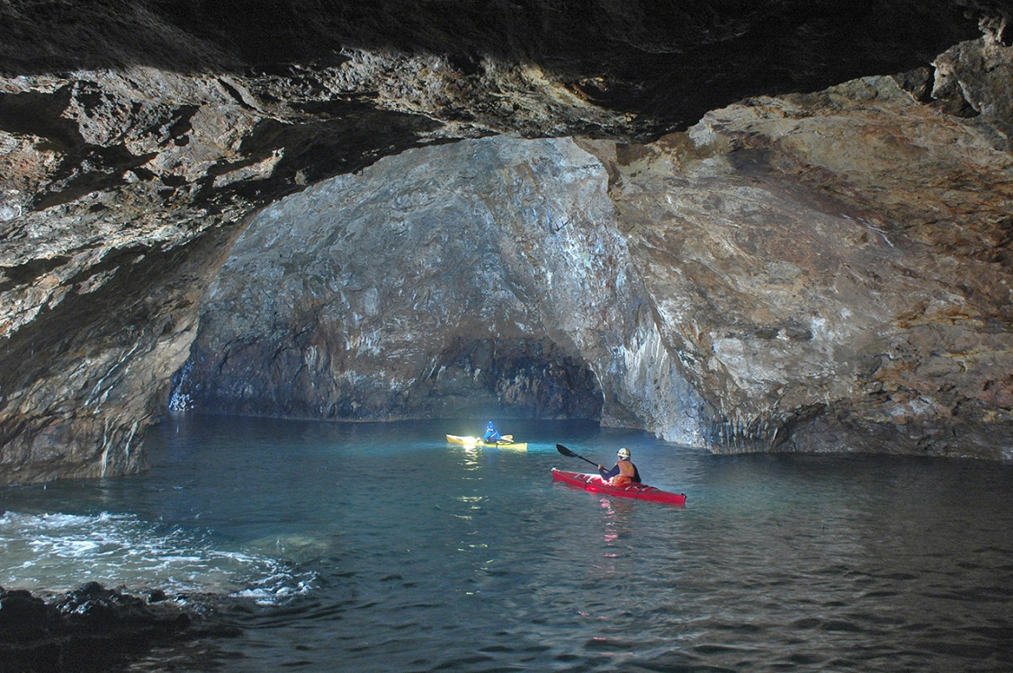
3. Sea Caves
Photo by Dave Bunnell
Notes:
Sea caves may be explored in several ways: with kayaks or other small boats; by swimming in; or in some caves, by wading or walking if the cave empties out at low tide.
This is a picture from Painted Cave on California's Santa Cruz Island. This is the world's second longest sea cave. It is 1,227 feet long and large enough to take a 40-foot boat inside.

Slide 12
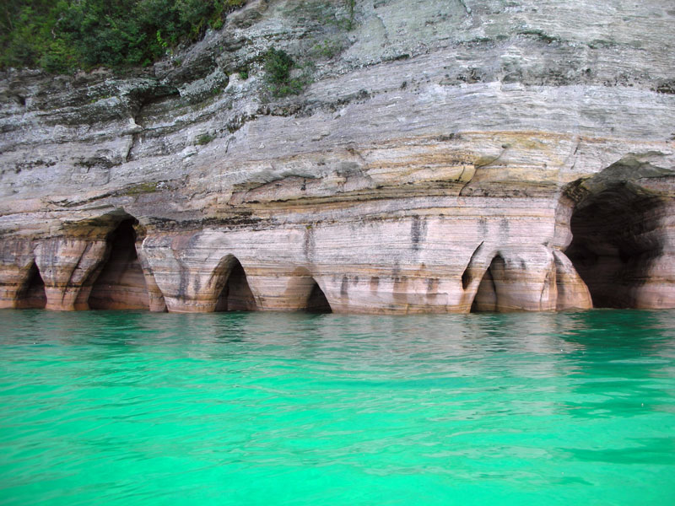
3. Sea Caves
Photo by National Park Service
Notes:
Most sea caves are formed by the power of oceans, but sometimes it’s the power of wave action in lakes that form these caves. This is a photo of Pictured Rocks National Lakeshore located in the Upper Peninsula of Michigan on the shore of Lake Superior.
These sandstone cliffs have been naturally sculptured into shallow caves and arches by the lake’s waves.

Slide 13
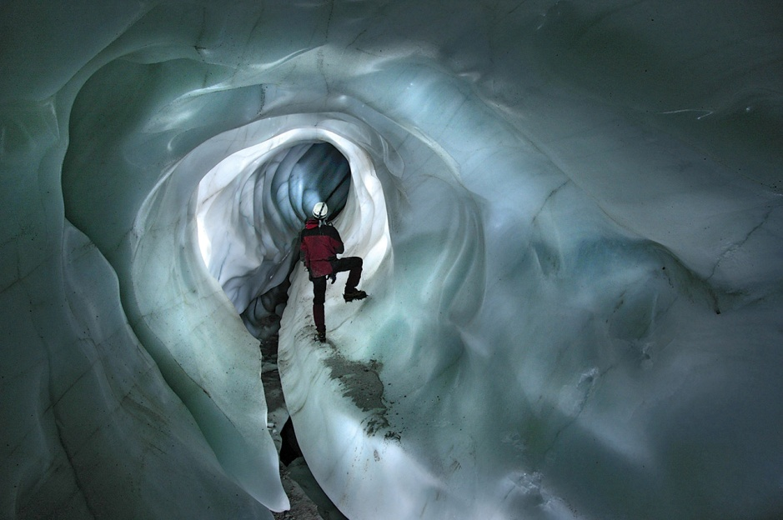
4. Glacier Caves
Photo by Dave Bunnell
Notes:
Caves formed completely in ice are properly termed glacier caves.
Glacier caves are often form from flowing water entering the glacier through cracks or crevasses, which are then enlarged over time, both by erosion and melting.

Slide 14
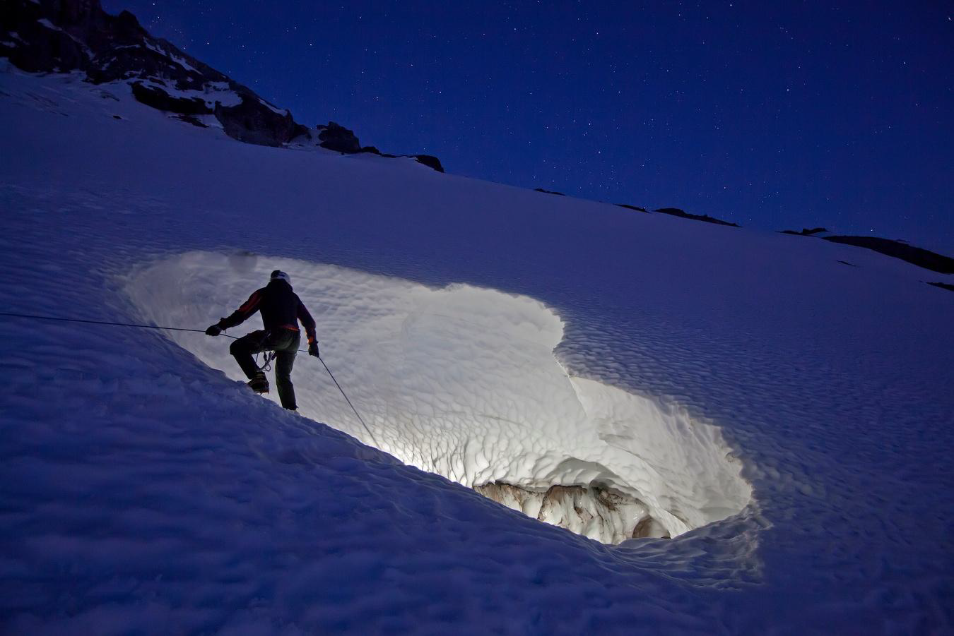
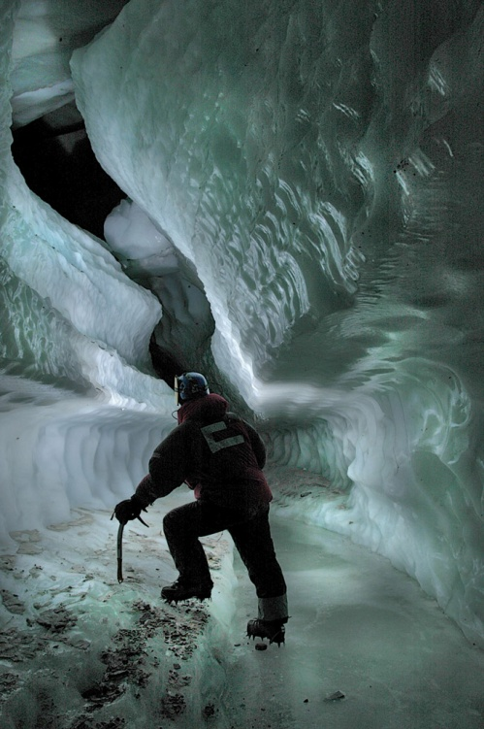
4. Glacier Caves
Glacier caves are formed completely in ice.
Glacier Caves are dynamic.
Large glacier caves have disappeared as glaciers around the world melt and retreat due to global warming.
Photo by Dave Bunnell
Photo by Brent McGregor
Notes:
A very interesting aspect of glacier caves is that they are very dynamic and change from year to year.
Large glacier cave systems have all but disappeared as glaciers melt and retreat around the world due to global warming.
The NSS currently has an expedition led by Eddy Cartaya to map, photograph, monitor the movement, of several cave passages that are located on the Sandy Glacier in Mt. Hood, Oregon.
During their latest expedition, they were able to map 2500 feet of new passage which enabled them to connect three cave systems. This newly connected system now comprises the longest and the largest glacier cave in the lower 48 states, and the deepest cave in Oregon.

Slide 15
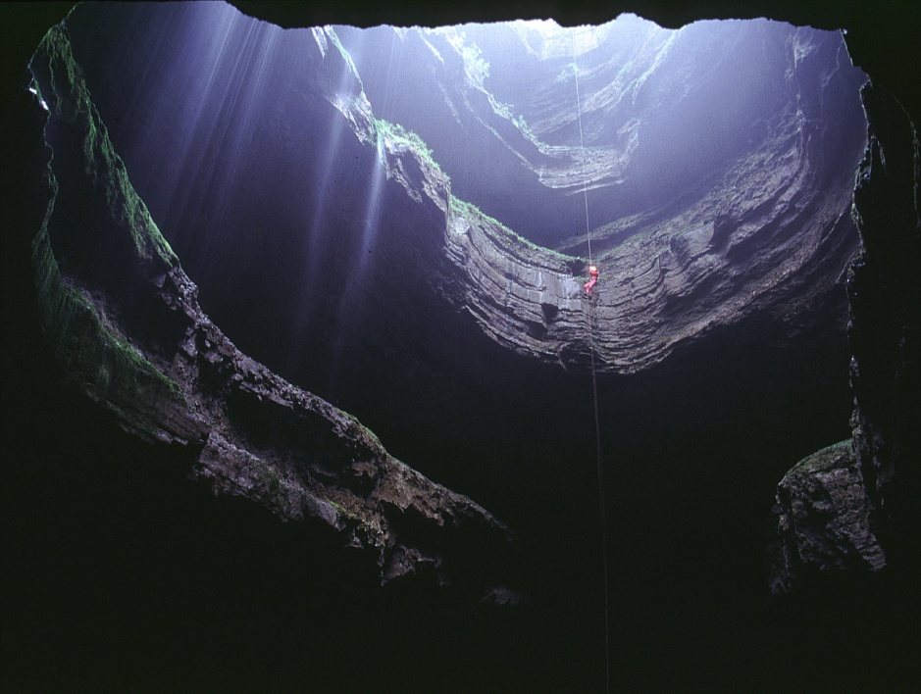
5. Solution Caves
Photo by Dave Bunnell
Notes:
The last cave type that I am going to discuss is also my favorite – solution caves. Solution Caves are the caves that most people are familiar with and this is the group of caves that the rest of our presentations will focus on.
Solution caves are dissolved out of solid rock by acidic waters. Most solution caves are found in carbonate rocks (limestone, dolomite, or marble) or gypsum.

Slide 16
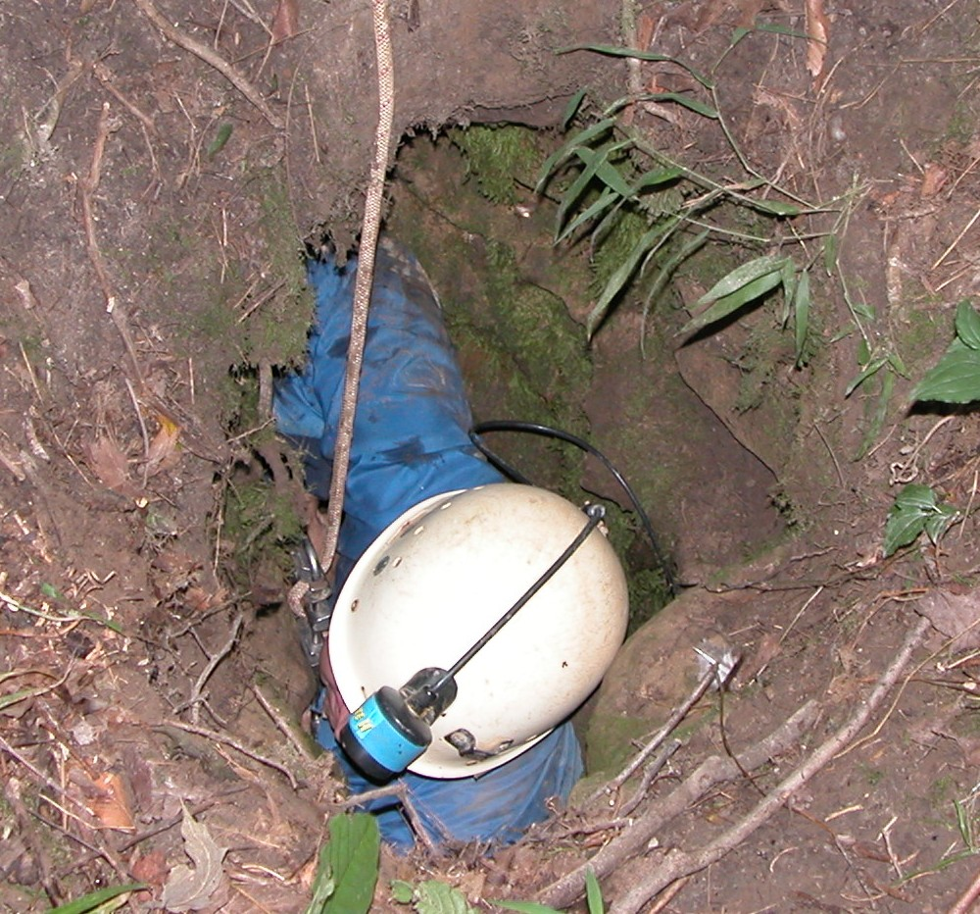
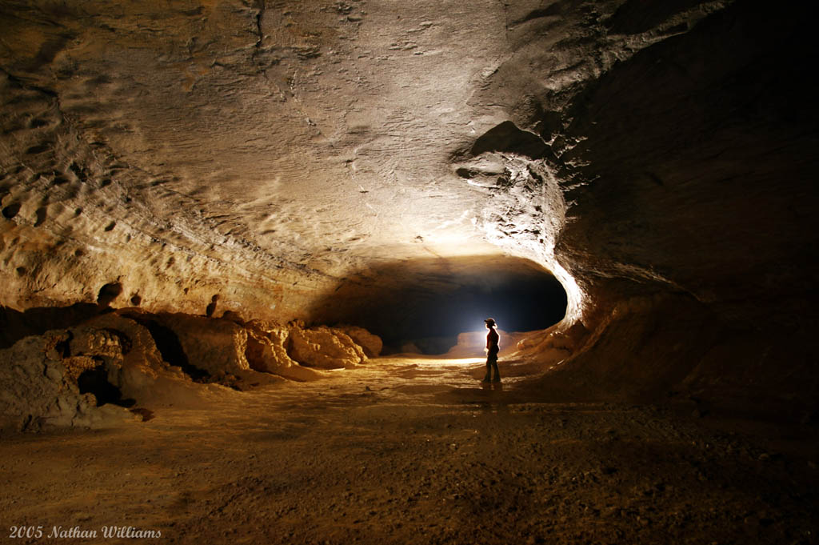
5. Solution Caves
Photo by Jerry Lewis
Notes:
Solution caves can be absolutely enormous.
For instance, this is a passage in Mammoth Cave located in Kentucky. This is the world’s largest cave system with over 390 miles of mapped passageways.
But, solution caves can also be small and may require stooping or even belly crawling.

Slide 17
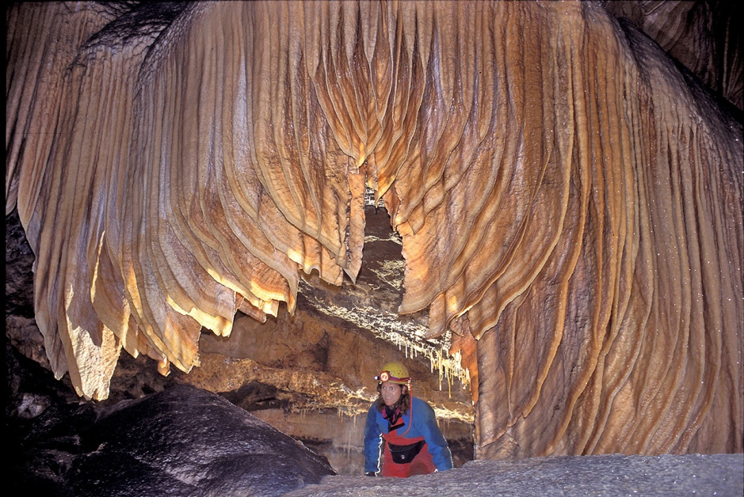
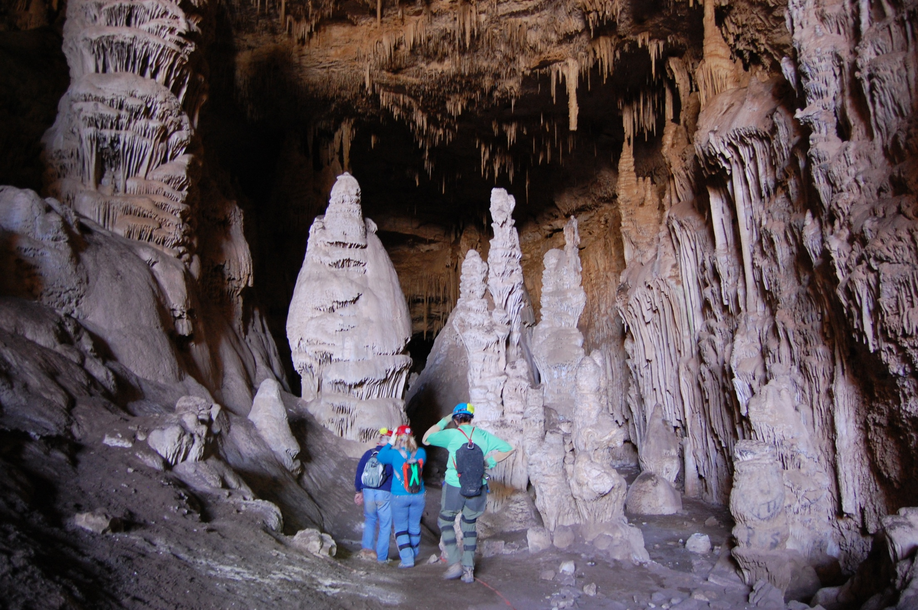
5. Solution Caves
Photo by Dave Bunnell
Photo by J.D. Mizer
Notes:
And, solution Caves can contain an astounding variety of speleothems, things such as stalactites and stalagmites, draperies, and much more. These formations formed over thousands of years and are very fragile.
CLICK
In the beginning of my presentation I mention that we have the ability to impact caves. We are responsible for conserving all of the resources that are found in caves such as fragile formations, fossils, and of course, cave life.

